Slide 1

Malignant Comments Classifier Project.
Presented By : Akash Kumar

Slide 2
AGENDA.
Overview
Problem Statement.
Problem Understanding.
Importance of Malignant Comments Classification.
Exploratory Data Analysis (Steps).
Visualizations.
Word Clouds.
Data Analysis Steps.
Model Building.
Analysis of Models.
Cross Validation Scores.
Hyper Parameter Tuning and Creating the Final Model.
ROC-AUC Curve.
Saving the model and predicting the results.
Conclusion.

Slide 3
OVERVIEW.
In this particular presentation we will be looking at:
How to analyze the dataset of Malignant Comment Classifier.
What are the EDA steps in cleaning the dataset.
Overall analysis on the problem.
Model building from the cleaned dataset.
Predictions for test dataset from saved model.

Slide 4
Problem STATEMENT.
The proliferation of social media enables people to express their opinions widely online. However, at the same time, this has resulted in the emergence of conflict and hate, making online environments uninviting for users. Although researchers have found that hate is a problem across multiple platforms, there is a lack of models for online hate detection.
Online hate, described as abusive language, aggression, cyber bullying, hatefulness and many others has been identified as a major threat on online social media platforms. Social media platforms are the most prominent grounds for such toxic behaviour. There has been a remarkable increase in the cases of cyber bullying and trolls on various social media platforms. Many celebrities and influences are facing backlashes from people and have to come across hateful and offensive comments. This can take a toll on anyone and affect them mentally leading to depression, mental illness, self-hatred and suicidal thoughts.

Slide 5
Problem STATEMENT.
Internet comments are bastions of hatred and vitriol. While online anonymity has provided a new outlet for aggression and hate speech, machine learning can be used to fight it. The problem we sought to solve was the tagging of internet comments that are aggressive towards other users. This means that insults to third parties such as celebrities will be tagged as un offensive, but “u are an idiot” is clearly offensive.

Slide 6
Problem UNDERSTANDING.
In the past few years, it is seen that the cases related to social media hatred have increased exponentially. The social media is turning into a dark venomous pit for people now a days. Online hate is the result of difference in opinion, race, religion, occupation, nationality etc. In social media the people spreading or involved in such kind of activities uses filthy languages, aggression, images etc. to offend and gravely hurt the person on the other side. This is one of the major concerns now.
The result of such activities can be dangerous. It gives mental trauma to the victims making their lives miserable. People who are not well aware of mental health online hate or cyber bullying become life threatening for them. Such cases are also at rise. It is also taking its toll on religions. Each and every day we can see an incident of fighting between people of different communities or religions due to offensive social media posts.

Slide 7
Importance of Malignant Comments Classifier.
Every day, we get a tremendous amount of short content data from the blast of online correspondence, web-based business and the utilization of advanced gadgets. This volume of data requires text mining apparatuses to carry out the various report tasks in an opportune and suitable way. Detecting and controlling verbal abuse in an automated fashion is inherently an NLP task (Natural Language Processing). Text Classification is a great point for NLP.
Nowadays, every social media site and applications use machine learning approach. Machine Learning has simplified the task that may take long duration to complete without it. Most of the approaches require text analysis and classification techniques. Classification of the comments is necessary before posting on online platforms. This classification model helps to prevent the online abuse and cyber bullying.

Slide 8
Exploratory Data Analysis.
Importing necessary libraries and importing the Train & Test datasets.
Checked some statistical information like shape, number of unique values present, info, finding zero values etc on both the datasets.
Checked for null values and did not find any null values In both datasets. And removed Id.
Conducted some feature engineering and created new columns via label: which contain both good and bad comments which is the sum of all the labels, comment length: which contains the length of comment text.
Visualized each feature using seaborn and matplotlib libraries by plotting categorical plots like pie plot, count plot, distribution plot and word cloud for each label.

Slide 9
Exploratory Data Analysis.
Done text pre-processing techniques like Removing Punctuations and other special characters, Splitting the comments into individual words, Removing Stop Words, Stemming and Lemmatization.
Then created new column as clean_length after cleaning the data.
All these steps were done on both train and test datasets.
Checked correlation using heatmap.
After getting a cleaned data used TF-IDF vectorizer.
Lastly, proceeded with model building.

Slide 10
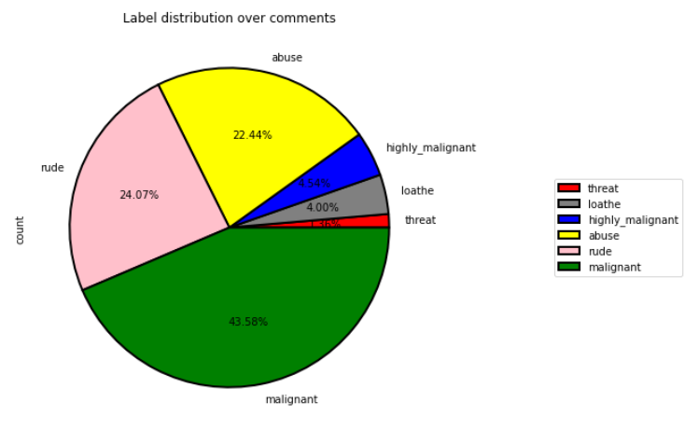
VISUALIZATIONS.
OBSERVATIONS:
From the pie chart we can notice approximately 43.58 % of the comments are malignant, 24.07 % of the comments are rude and 22.44 % are abuse. The count of malignant comments are high compared to other type of comments and the count of threat comments are very less.

Slide 11
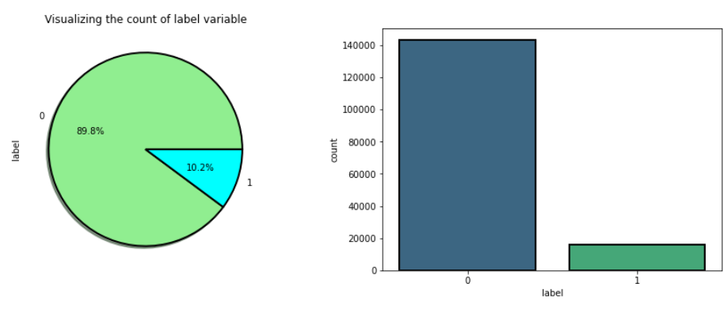
VISUALIZATIONS.
OBSERVATIONS: From the above plots we can observe the count of negative comments are high compared to the non negative comments. Here around 89.8% of the comments are turned out to be negative comments and only 10.2 % of them are considered to be positive or neutral comments. We can also observe the data imbalance issue here, we need to balance the data.

Slide 12
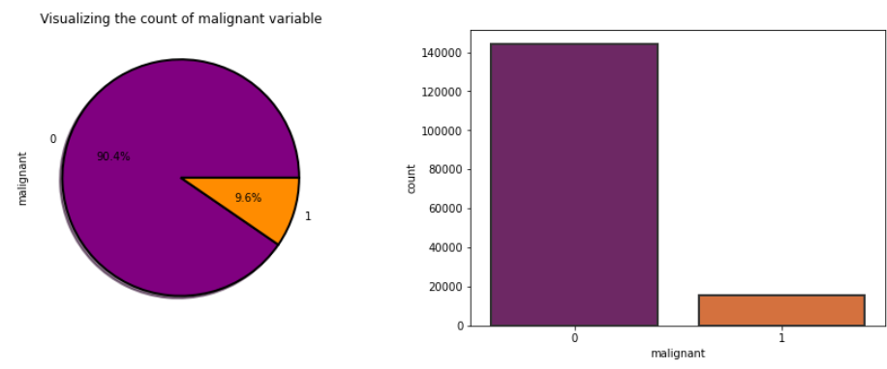
VISUALIZATIONS.
OBSERVATIONS:
From the above plots we can observe the count of malignant comments is high compared to non malignant comments. That is around 90.4 % of the comments are malignant and only 9.6 % of the comments are good.

Slide 13
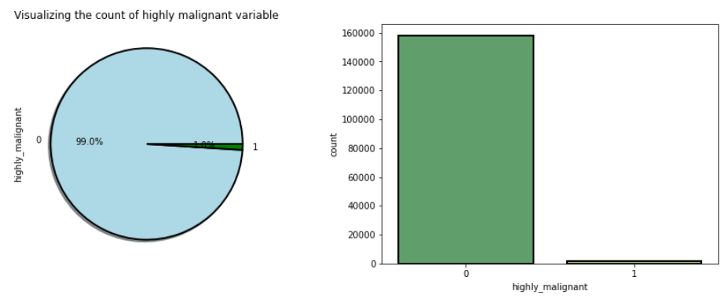
VISUALIZATIONS.
OBSERVATIONS:
From the plot we can observe that the count of highly malignant comments is very high, which is about 99 % and only 1 % of the comments are normal.

Slide 14
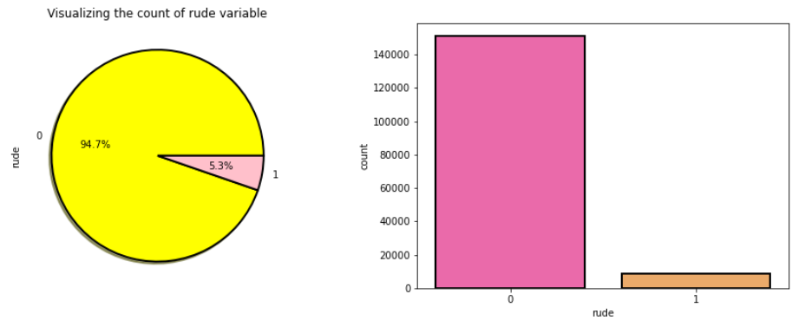
VISUALIZATIONS.
OBSERVATIONS:
The number of rude comments are high compared to normal comments. Around 94.7 % of the comments fall into rude and remaining comments are considered to be normal comments.

Slide 15
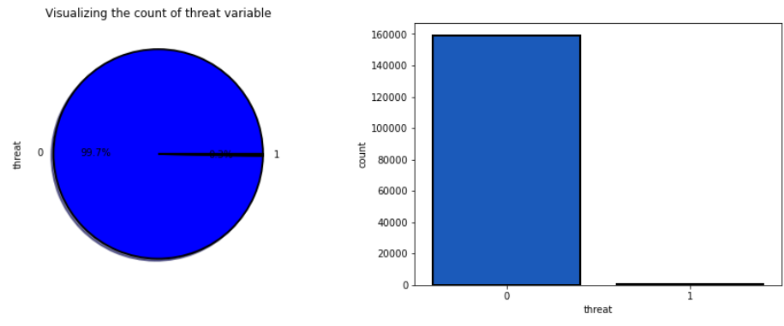
VISUALIZATIONS.
OBSERVATIONS:
In the above visualization also, 99.7 % of the comments are threatening and only 0.3 % of the comments look normal.

Slide 16
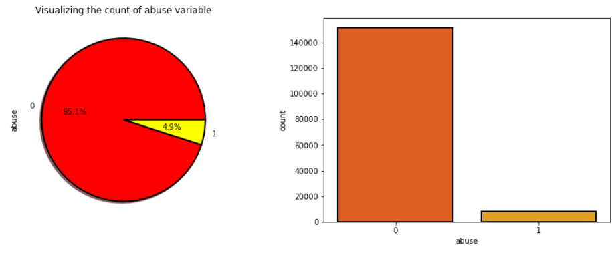
VISUALIZATIONS.
OBSERVATIONS:
The count of abusing type comments is high which is 95.1 % and only 4.9 % of the comments are normal.

Slide 17
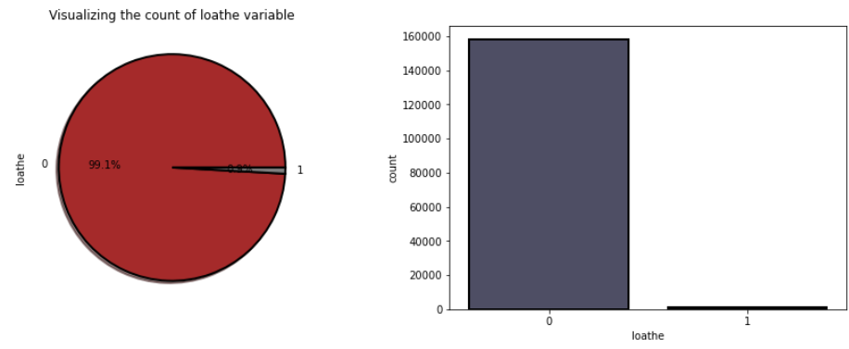
VISUALIZATIONS.
OBSERVATIONS:
The count of loathe is high (99.1 %) compared to normal (0.9 %) text comments.

Slide 18
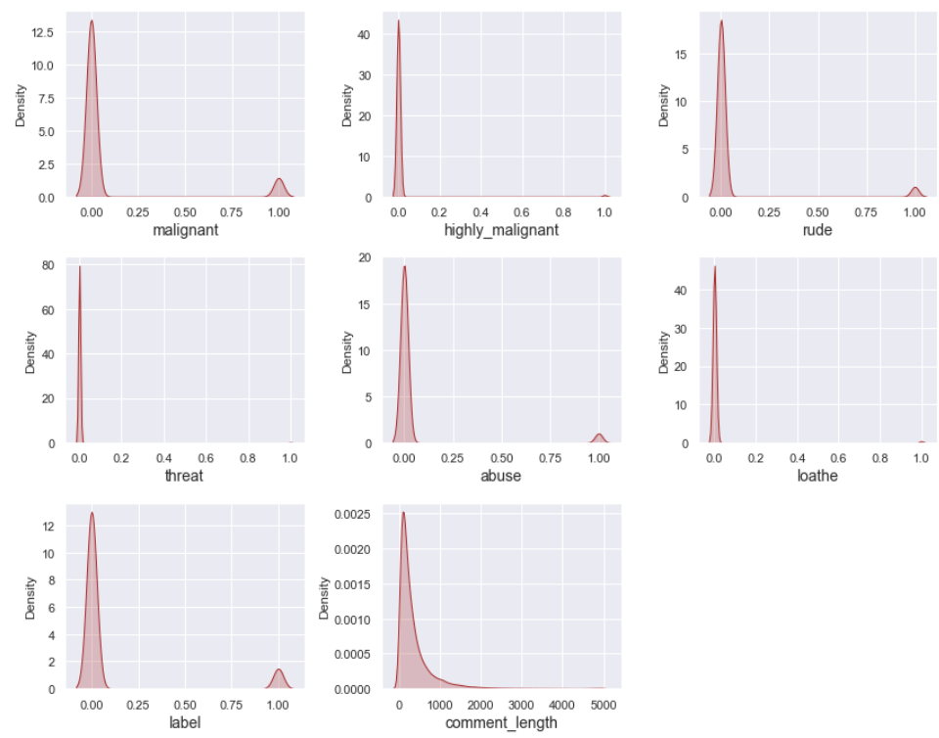
VISUALIZATIONS.
OBSERVATIONS:
From the distribution plots we can notice that all the columns are skewed to the right except the comment_label column. Since all the columns are categorical in nature there is no need to remove skewness and outliers in any of the columns.

Slide 19
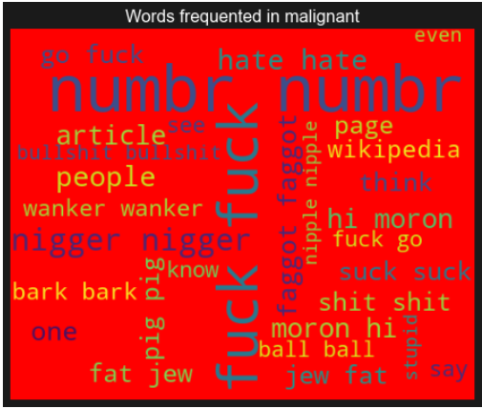
Word Clouds.
OBSERVATIONS:
These are the toxic words which frequently appear in the Malignant column.

Slide 20
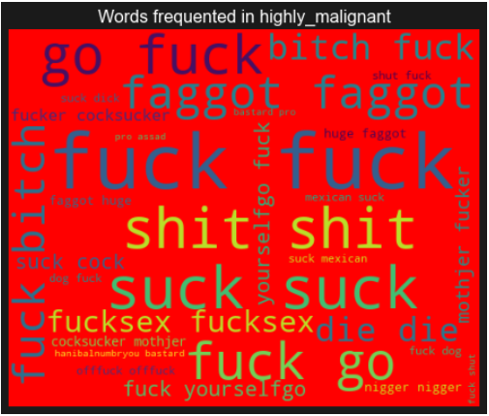
Word Clouds.
OBSERVATIONS:
These are the toxic words which frequently appear in the Highly Malignant column.

Slide 21
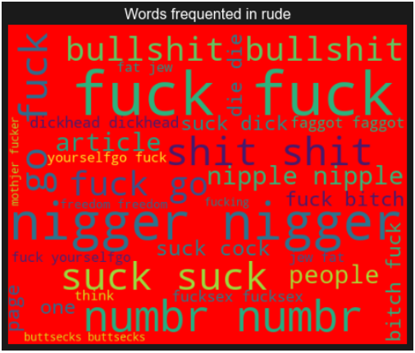
Word Clouds.
OBSERVATIONS:
These are the toxic words which frequently appear in the rude column.

Slide 22
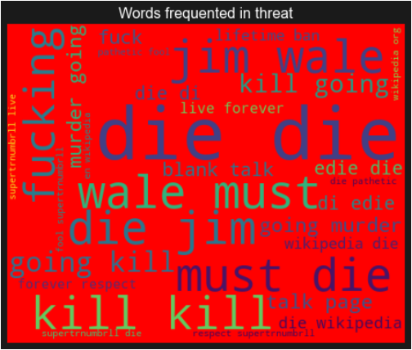
Word Clouds.
OBSERVATIONS:
These are the toxic words which frequently appear in the threat column.

Slide 23
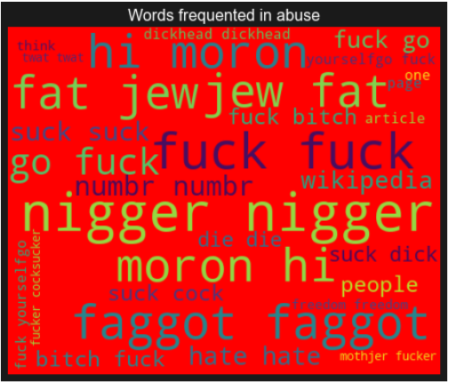
Word Clouds.
OBSERVATIONS:
These are the toxic words which frequently appear in the abuse column.

Slide 24
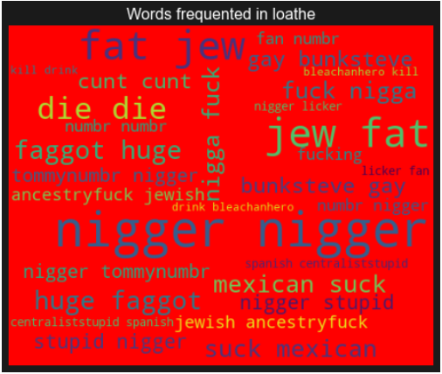
Word Clouds.
OBSERVATIONS:
These are the toxic words which frequently appear in the loathe column.

Slide 25
DATA ANALYSIS STEPS.
I have extracted some features and removed the feature “Id” to improve data normality and linearity.
Done text pre-processing techniques like: Removing Punctuations and other special characters, Splitting the comments into individual words, Removing Stop Words, Stemming and Lemmatization.
Then created new column as clean_length after cleaning the data.
All these steps were done on both train and test datasets.
Used Pearson’s correlation coefficient and heat map to check the correlation.

Slide 26
DATA ANALYSIS STEPS.
After getting a cleaned data used TF-IDF vectorizer. It’ll help to transform the text data to feature vector which can be used as input in our modelling.
Balanced the data using Random-oversampler mechanism.
Split train and test to build machine learning models.
Model building process will be shown in the further steps.

Slide 27
MODEL BUILDING.
In this project there were 6 features which defines the type of comment like malignant, hate, abuse, threat, loathe but we created another feature named as “label” which is combined of all the above features and contains the labeled data into the format of 0 and 1 where 0 represents “NO” and 1 represents “Yes”.
In this NLP based project we need to predict the multiple labels which are binary. I have converted text into feature vectors using TF-IDF vectorizer and separated our features and labels. Also, before building the model, I made sure that the input data was cleaned and scaled before it was fed into the machine learning models.
After the pre-processing and data cleaning I used remaining independent features for model building and prediction.

Slide 28
MODEL BUILDING.
The classification algorithms used on training the data are as follows:
Logistic Regression Model
Decision Tree Classifier Model
Linear SVC Model
Multinomial NB Classifier Model
Ada Boost Classifier Model
Extreme Gradient Boosting Classifier (XGB) Model
Extra Trees Classifier Model

Slide 29
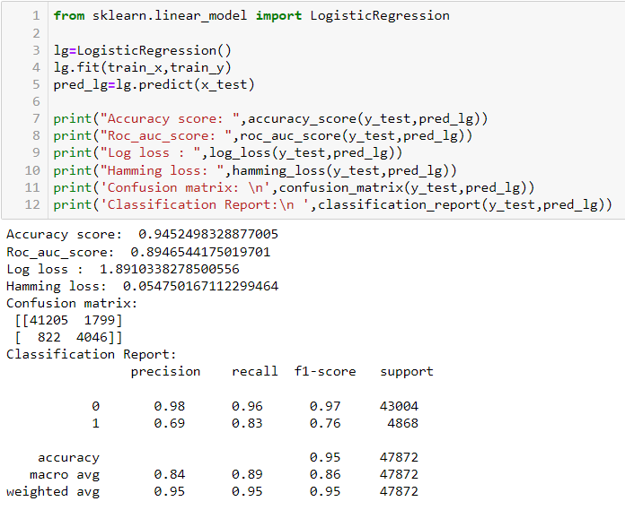
LOGISTIC REGRESSION MODEL.
The Logistic Regression Model gave us an accuracy score of 94.52 %.

Slide 30
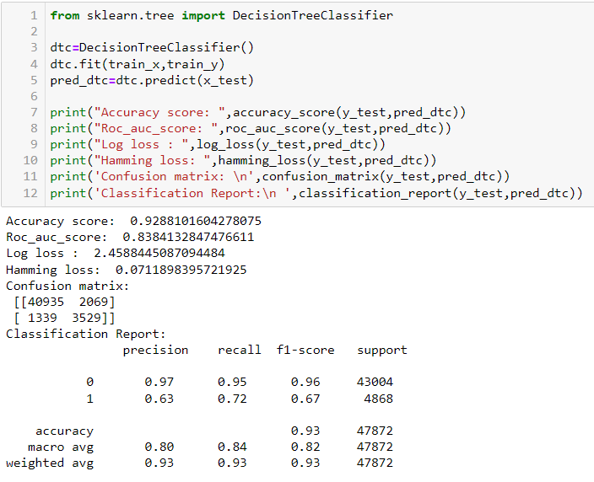
DECISION TREE CLASSIFIER MODEL.
The Decision Tree Classifier Model gave us an accuracy score of 92.88 %.

Slide 31
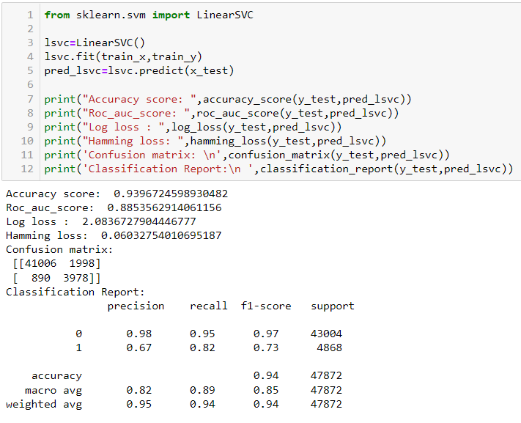
LINEAR SVC MODEL.
The Linear SVC Model gave us an accuracy score of 93.96 %.

Slide 32
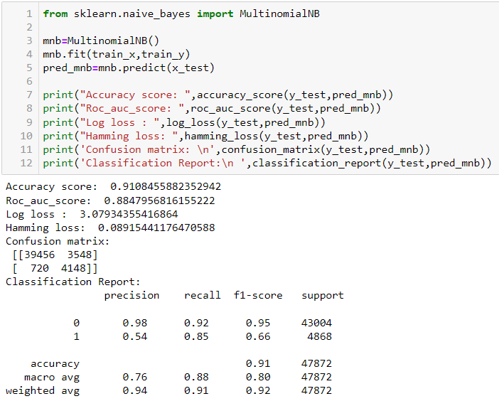
MULTINOMIALNB CLASSIFIER MODEL.
The MULTINOMIALNB CLASSIFIER Model gave us an accuracy score of 91.08 %.

Slide 33

ADABOOST CLASSIFIER MODEL.
The ADA Boost CLASSIFIER Model gave us an accuracy score of 92.61 %.

Slide 34
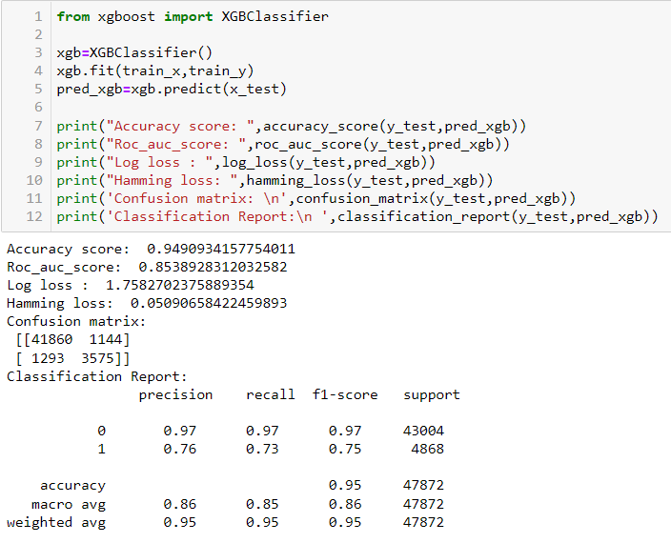
XGBoost CLASSIFIER MODEL.
The XG Boost CLASSIFIER Model gave us an accuracy score of 94.90 %.

Slide 35
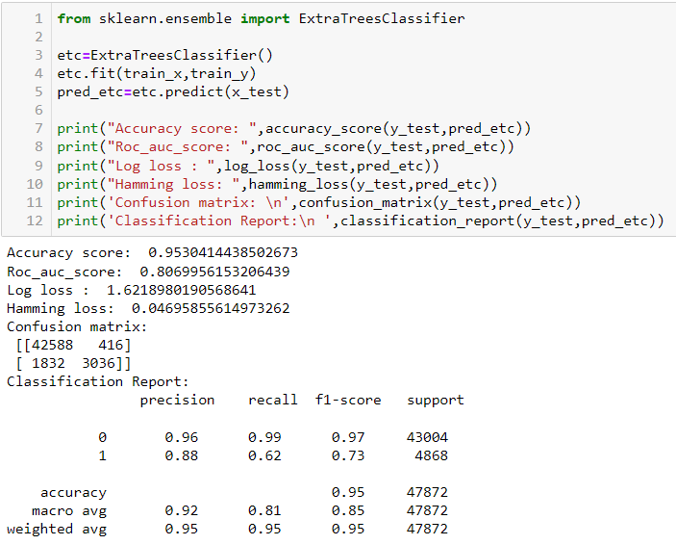
EXTRA TREES CLASSIFIER MODEL.
The Extra Trees CLASSIFIER Model gave us an accuracy score of 95.30 %.

Slide 36
Analysis of Models.
From the above Classification Models, the highest accuracy score belongs to the Extra Trees Classifier, followed by the XG Boost Classifier and Logistic Regression Model.
Next, the Linear SVC Model followed by the Ada Boost Classifier and the Decision Tree Classifier.
Lastly the Multinomial NB Classifier Model.

Slide 37
Cross Validation Scores.
The cross validation score of the Logistic Regression Model is 94.52 %.
The cross validation score of the Decision Tree Classifier Model is 92.88 %.
The cross validation score of the Linear SVC Model is 93.96 %.
The cross validation score of the Multinomial NB Classifier Model is 91.08 %.
The cross validation score of the Ada boost classifier Model is 92.61 %.
The cross validation score of the XG Boost Classifier Model is 94.90 %.
The cross validation score of the Extra Trees Classifier Model is 95.30 %.
From the above Cross Validation Scores, the highest CV score belongs to the Linear SVC model, followed by the Extra Trees Classifier & Logistic Regression Model. Next the XG Boost Classifier model , the Multinomial NB Classifier and the Ada Boost Classifier Model. Lastly, the Decision Tree Classifier.

Slide 38
HYPER PARAMETER TUNING.
Since the Accuracy Score and the cross validation score of the Logistic Regression Model are good and the AUC score is the highest among others we shall consider this model for hyper parameter tuning.
We shall use Grid SearchCV for hyper parameter tuning.
After multiple tries with hyper parameter tuning, the highest accuracy score obtained was 94.56 %.

Slide 39
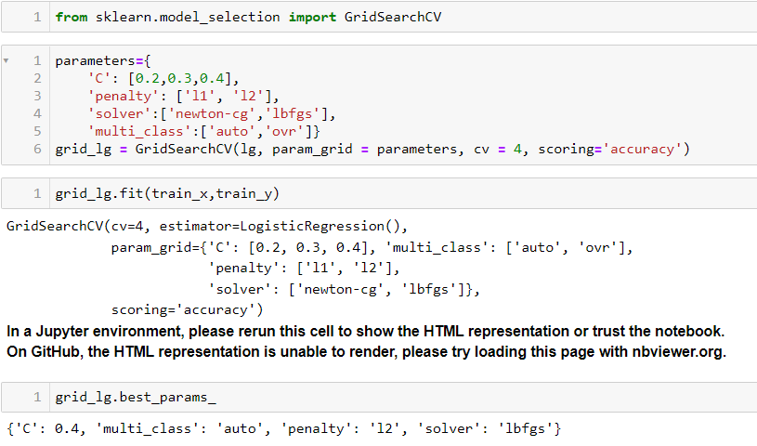
HYPER PARAMETER TUNING.

Slide 40
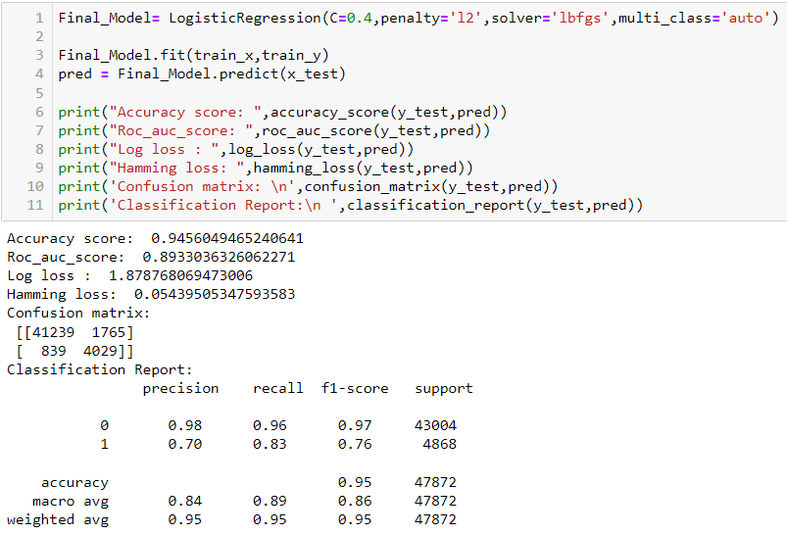
HYPER PARAMETER TUNING [FINAL MODEL].
I have successfully incorporated hyper parameter tuning using best parameters of Logistic Regression and the accuracy of the model has been increased, We received the accuracy score as 94.56%, which is very good.

Slide 41
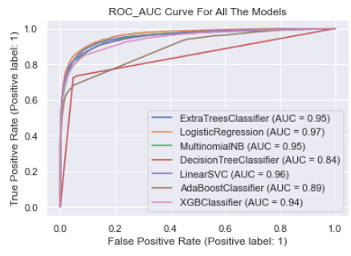
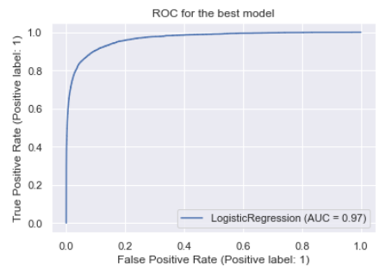
ROC-AUC Curve.
I have generated the ROC Curve for all the models and for the best model and compared it with AUC. The AUC score for my final model was 97%.

Slide 42
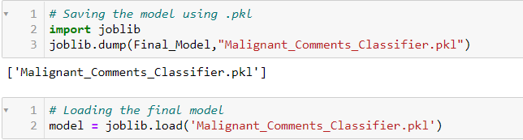
Saving the model and predicting the results.
I have saved my final best model using joblib library in .pkl format, and loaded saved model for predictions for test data. Using classification model, we have got the predicted values for malignant comments classification.

Slide 43
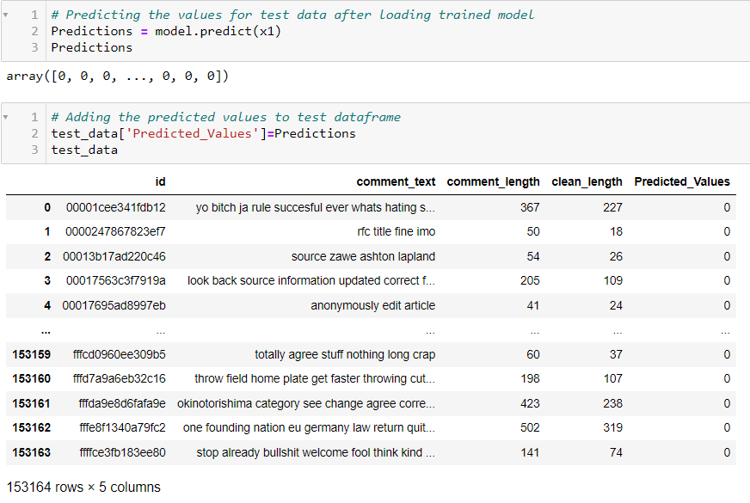
Saving the model and predicting the results.

Slide 44
CONCLUSION.
This project gives an idea of NLP text processing in machine learning. Apart from applying the techniques that we have learnt in the EDA, we also classified hate and offensive comments so that it can be controlled and restricted from spreading hatred and cyber bullying.
From this dataset we were able to understand the idea of Natural Language Processing using machine learning models. This model helps us to understand whether the online comments are malignant or non malignant.
We have mentioned step by step procedure to analyze the data and checked the correlation between label and feature.

Slide 45
CONCLUSION.
We got the Logistic Regression Model as the best model and performed hyper parameter tuning using the best parameters of Logistic Regression and plotted AUC-ROC score and the model accuracy and roc-auc score increased after tuning.
After that we saved the model in a pickle with a filename in order to use whenever we require. Then we loaded the saved file and predicted the values for test data. Further we saved the predicted values test data into a csv file.
THANK YOU…

